Slide 1


FIFA Player Performance Prediction Using Machine Learning Techniques

Slide 2


Slide 3

With what accuracy can the FIFA player performance be predicted using machine learning techniques?

Slide 4
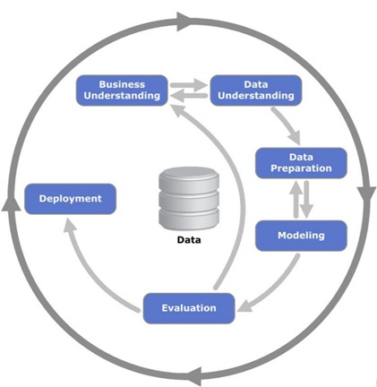
Methodology

Slide 5

Data Pre-processing

Slide 6
Model Implementation
Linear Regression
Decision
Tree
Random
Forest
Linear
SVR
Gradient
Boosting
XGBOOST
LASSO

Slide 7
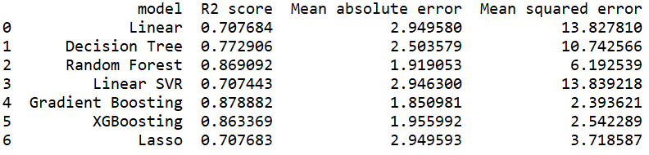
Performance Evaluation
RMSE
MAE
MSE
R Square

Slide 8
Evaluation Results

Slide 9
Thank You

